Slide 1

The Technology Value Stream
Miles Shinsato
CSD-380-306J_2273_DD
October 25, 2026

Slide 2

What is the Technology Value Stream?
“the process required to convert a business hypothesis into a technology-enabled service or feature that delivers value to the customer” (Kim et al., 2016)
The Value Stream starts as soon as a customer makes a request and it is added to the future plans

Slide 3
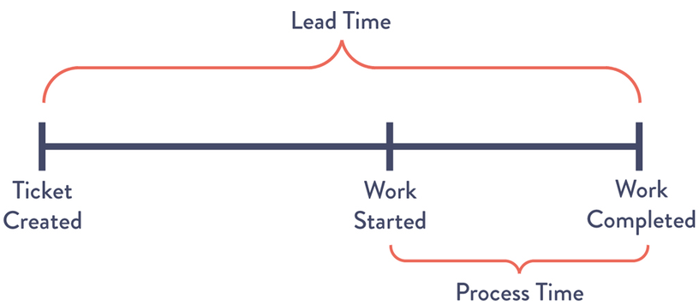
Lead Time vs Process Time
Lead time: Total time elapsed from a request being made until it is completed
Process time: Time elapsed from when work starts until it is completed

Slide 4

The Common Scenario: Deployment Takes Months
Teams work separately and pass work between departments (Waterfall development)
Testing, approvals, and deployment may be manual
Merging code can lead to lengthy investigations if there are errors
Releases become large, infrequent, and risky

Slide 5

The DevOps Approach on Value Stream
More efficient development
improve response & deployment time
better customer experience

Slide 6

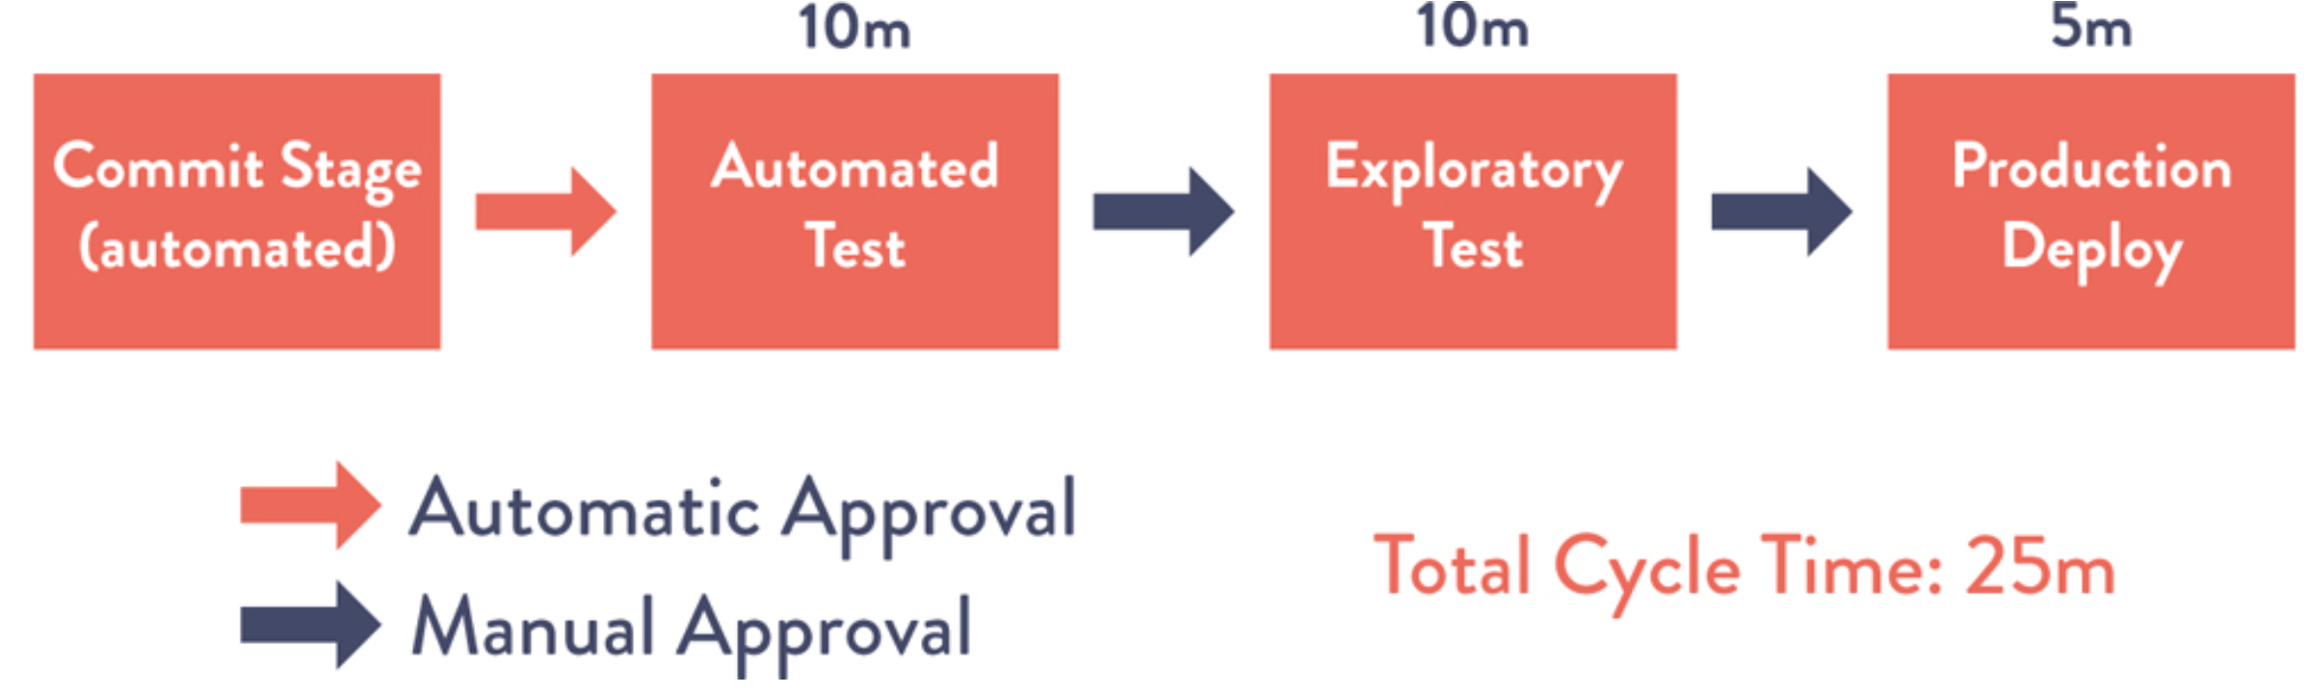
The DevOps Ideal: Deployment in Minutes
Automate building, testing, and deployment
Integrate development operations
Make smaller, more frequent changes
Identify problems quickly and receive feedback sooner

Slide 7
Reducing Lead Time
Automate repetitive tasks
Use continuous integration and continuous delivery (CI / CD)
Reduce unnecessary handoffs and bottlenecks
Share responsibility between development and operations
Use monitoring and feedback to improve the process

Slide 8

Why this matters
Earlier delivery of features and updates
Earlier feedback leading to earlier fixes
Smaller changes are easier to troubleshoot
Faster recovery through appropriate testing and monitoring

Slide 9

References
Kim, G., Debois, P., Willis, J., & Humble, J. (2016). The DevOps Handbook: How to Create World-Class Agility, Reliability, and Security in Technology Organizations. Agile, Continuous Delivery, and the Three Ways.
Quiroz-Vázquez, C. (n.d.). What is value stream management? Retrieved October 25, 2026, from https://www.ibm.com/think/topics/value-stream-management
Takakura, T. (n.d.). What is Value Stream Management (VSM) and Why is it Important? Atlassian. Retrieved October 25, 2026, from https://www.atlassian.com/agile/value-stream-management

